Slide 1
ANALYSIS OF CLIMATE CHANGE IMPACT TO GLOBAL WINE PRODUCTION

Slide 2
UCB Data Bootcamp Project 1
June 17th, 2024
Brenda M., Theresa F., Rinal S., Jeff K., Madison O.

Slide 3

Research questions
Which were the top wine producing countries in year X?
Which are the current top wine producing countries in year Y?
What is the correlation between temperature and wine production?

Slide 4

Research questions cont.
What is the correlation between precipitation and wine production?
What is the optimal temperature for maximum production?
What is the optimal precipitation level for maximum wine production?
For which countries has the climate changed to favorably or unfavorably impact wine production?

Slide 5
DATASETS
International Organization of Vine and Wine
Statistics https://www.oiv.int/what-we-do/statistics
Database Discovery Tool https://www.oiv.int/what-we-do/data-discovery-report?oiv
NOAA National Centers for Environmental Information
Data access https://www.ncei.noaa.gov/access
NCEI Data Service API User Documentation https://www.ncei.noaa.gov/support/access-data-service-api-user-documentation
Climate Data Online: Web Services Documentation https://www.ncdc.noaa.gov/cdo-web/webservices/v2#gettingStarted

Slide 6
Discussion & findings

Slide 7
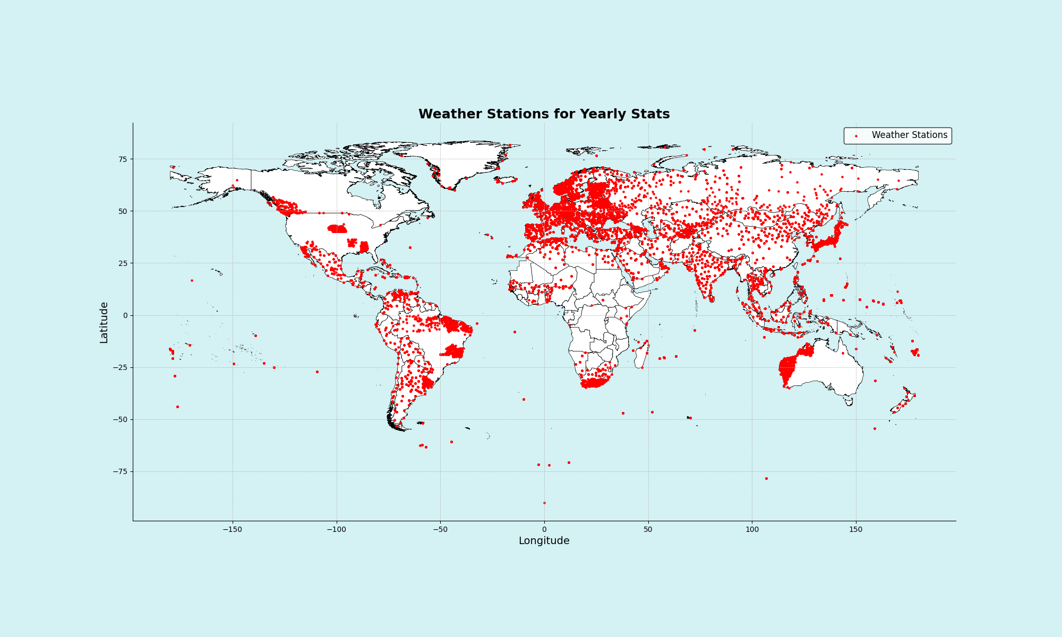
[INSERT]
…

Slide 8
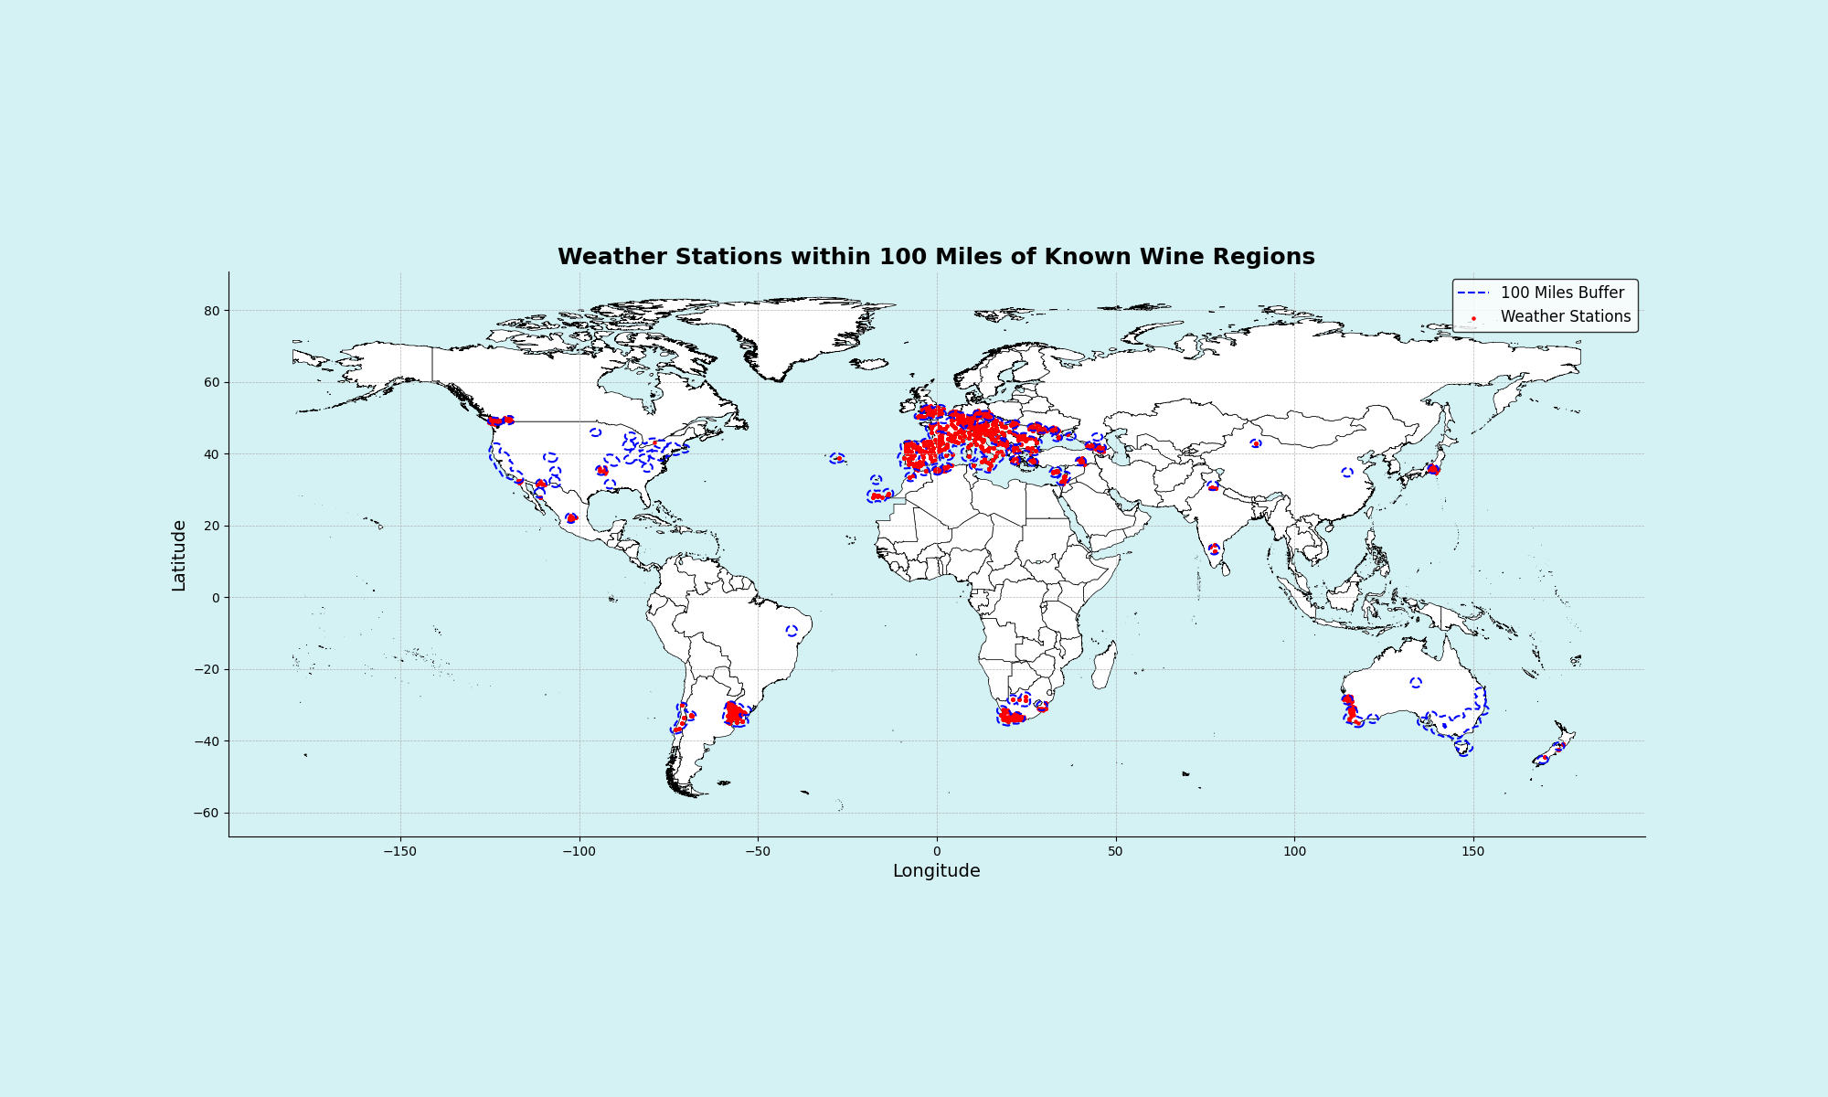
[INSERT]
…

Slide 9
[insert]
…
…
…
…

Slide 10
[INSERT]
19XX: …
20XX: …
20XX: …

Slide 11
overview
20XX
20XX
20XX
20XX

Slide 12
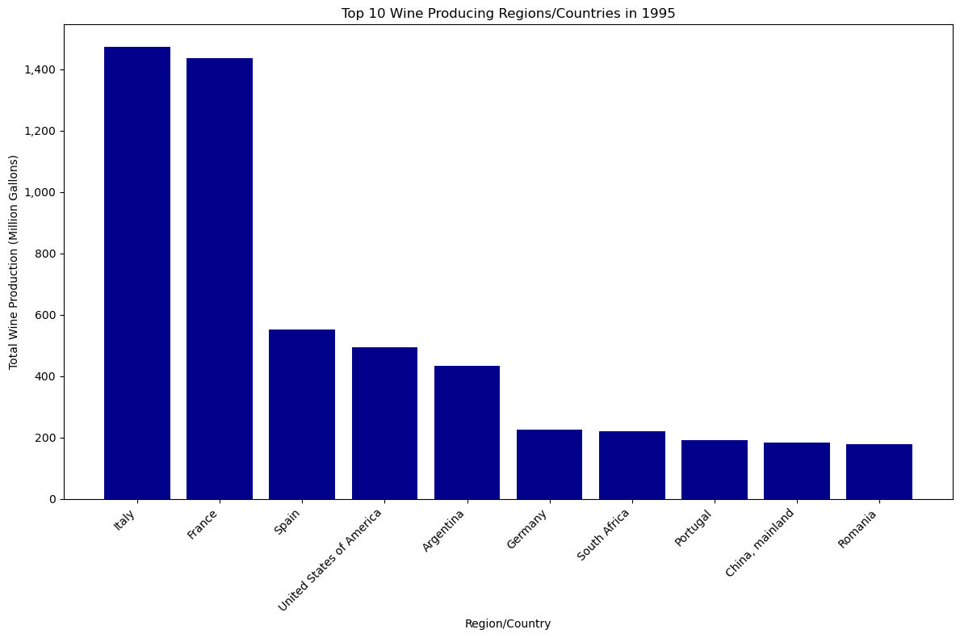
Summary
Top wine producing countries in 1995
Climate has a direct influence on grape crop development and the final yield. Hence why this analysis focused solely on climatic factors and their change over time.
Analysis range for total global wine production 1995 – 2023.
1995: ~6,000 million gallons
2023: ~4,000 million gallons
Focused in the mediterranean region

Slide 13
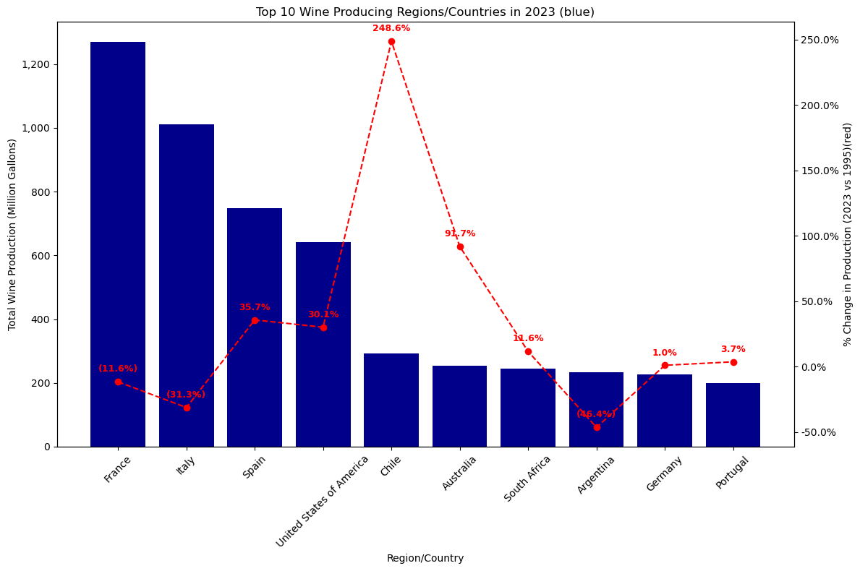
Summary continued
Top wine producing countries in 2023

Slide 14
References & resources

Slide 15

Thank you!
Q&A

